Slide 1
Hypothesis Testing in Python

Slide 2

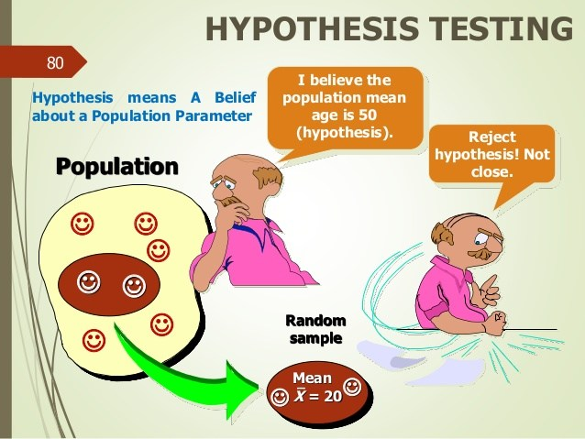

Slide 4

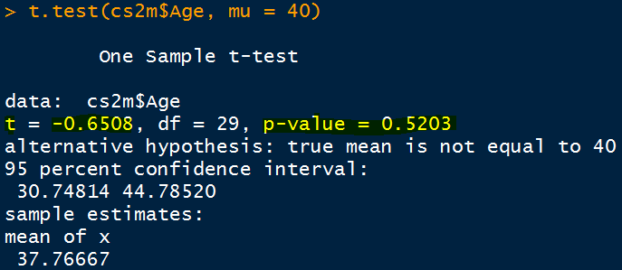
One Sample t test Ho: Hypothesized Mean population Age, mu = 40

Slide 5
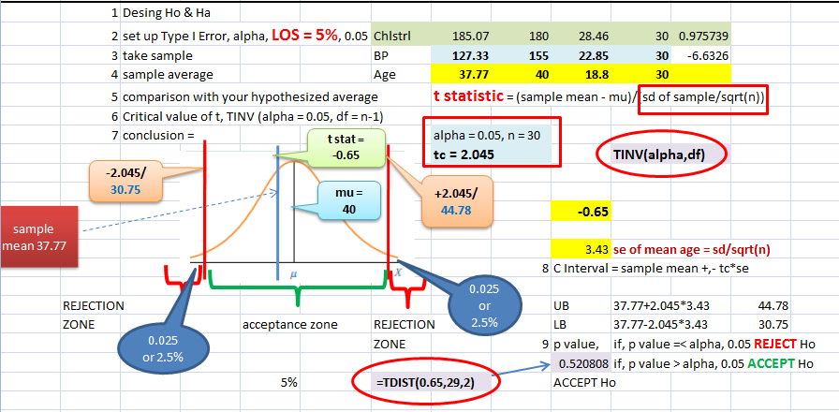
Ho: Hypothesized Mean population Age, mu = 40

Slide 6
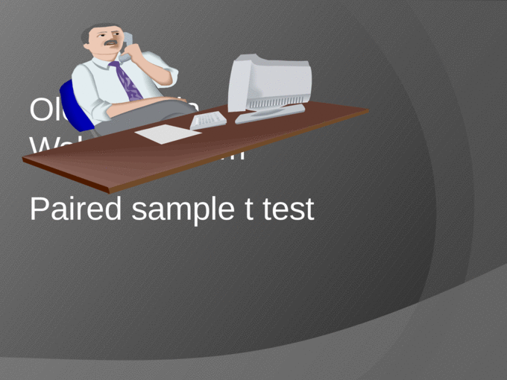

Slide 7

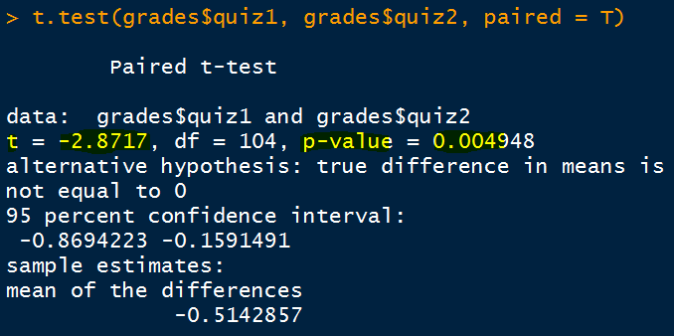
Paired sample: Ho: Mu of quiz1- Mu of quiz2 = 0
Python output is same as that of R

Slide 8
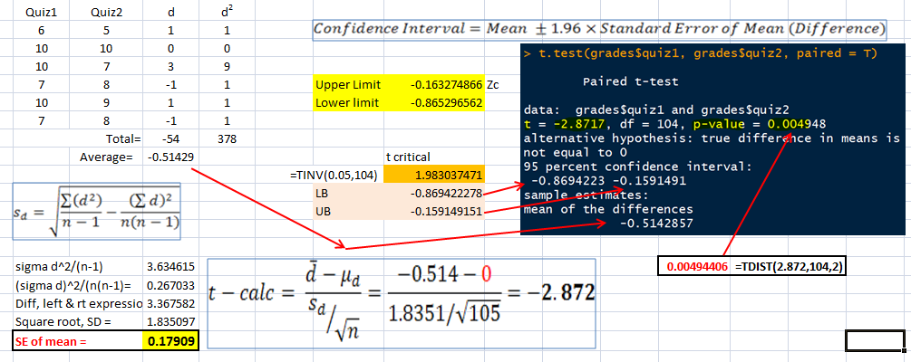
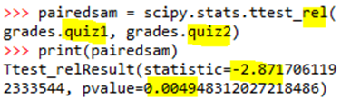
Paired sample: Ho: Mu of quiz1- Mu of quiz2 = 0
Python output is same as that of R

Slide 9
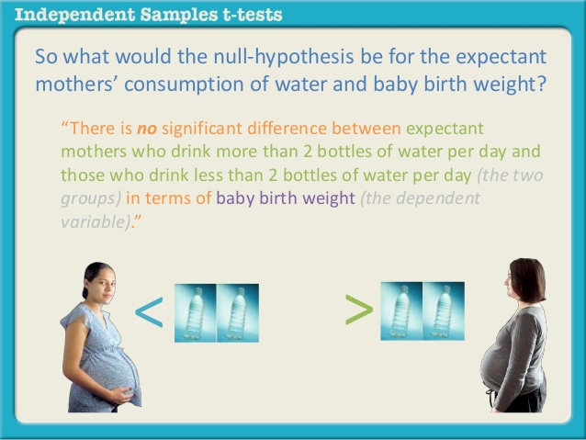

Slide 10
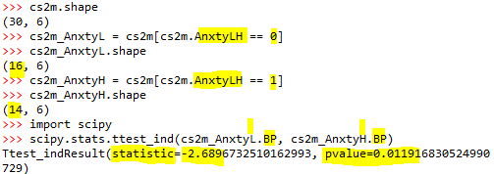
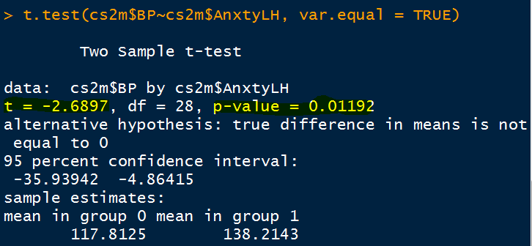
Independent Sample t test Ho: Population mean of BP across Anxiety levels are same
Create a data set having LOW Anxiety
Create a data set having HIGH Anxiety
Python output is same as that of R

Slide 11

Tip Independent sample t test is not that straight forward as in R. Need to create a data set having one chosen category only, say Pregnant like this: Prgnt = cs2m[cs2m.Prgnt == 1] NotPrgnt = cs2m[cs2m.Prgnt == 0] Then run the code to see the mean population difference in BP as: scipy.stats.ttest_ind(Prgnt.BP, NotPrgnt.BP)

Slide 12
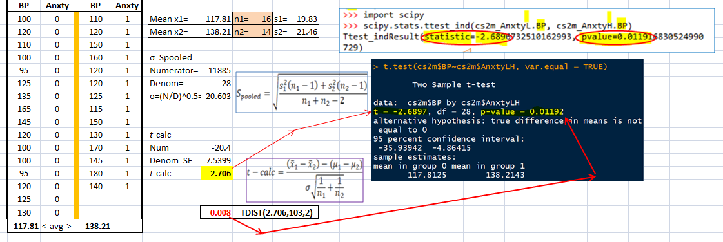
Independent Sample t test Ho: Population mean of BP across Anxiety levels are same

Slide 13


Slide 14

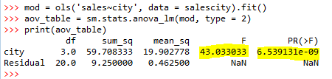
One Way ANOVA Ho: sales across city is same

Slide 15
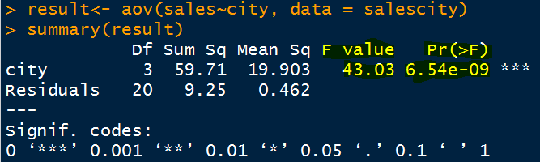
One Way ANOVA Ho: sales across city is same
Python output is same as that of R

Slide 16
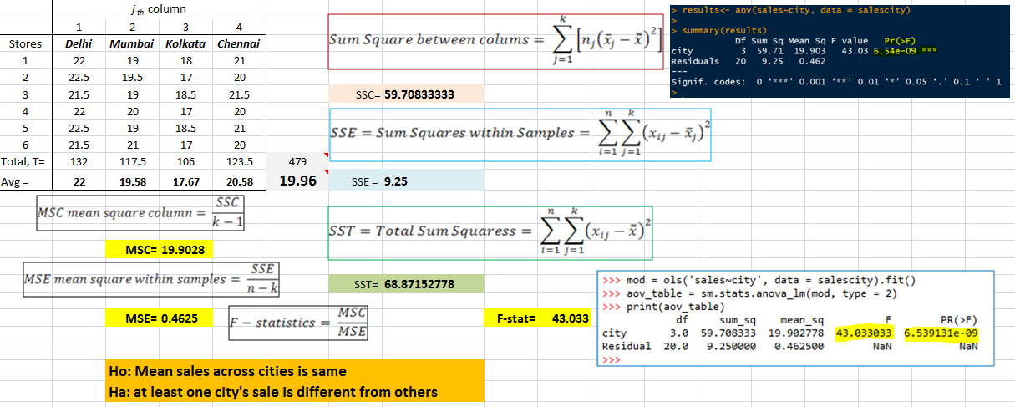
One Way ANOVA Ho: sales across city is same

Slide 17
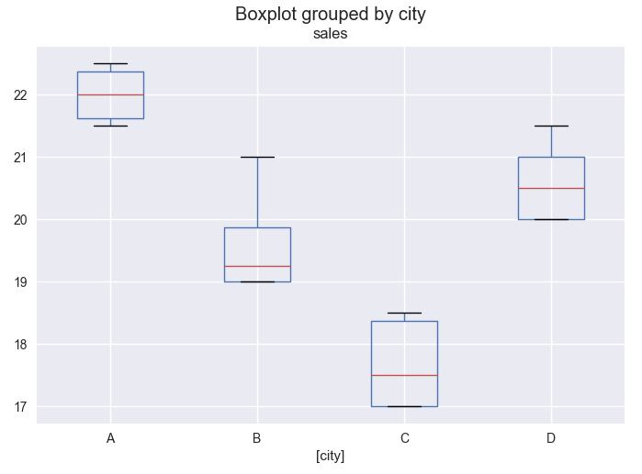
Boxplots of Sales vs City

Slide 18


Slide 19
Malaria Virus infection case
 | Recovered | Not Recover
Medicine given | 100 | 50 | 150
Medicine have not given | 25 | 125 | 150
 | 125 | 175 | 300

Slide 20
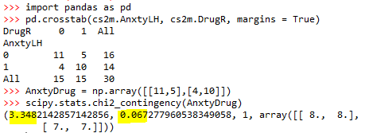
Chi Square Test Ho: There is no significant association between Anxiety and Drug Reaction
First, do crosstab then create array then use array in test

Slide 21
Tip Chi square test is not that straight forward as in R. Need to create cross tab of the two Categorical variables like: pd.crosstab(cs2m$Prgnt, cs2m$AnxtyLH, margins = True) Then create an array having observed frequencies/counts like: PrgntAnxty = np.array([[x1,x2], [x3,x4]]) Now, run the code as: stats.chi2_contingency(PrgntAnxty)
Be careful in feeding x1, x2, x3 & x4. Refer example of Anxiety versus Drug Reaction

Slide 22
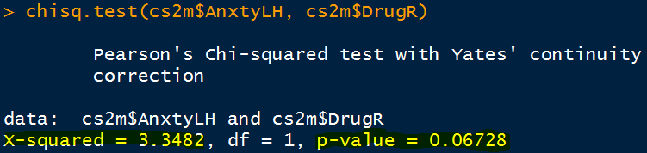
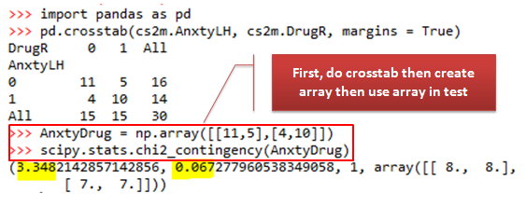
Chi Square Test Ho: There is no significant association between Anxiety and Drug Reaction
Same in R & Python
Same in Python & R

Slide 23
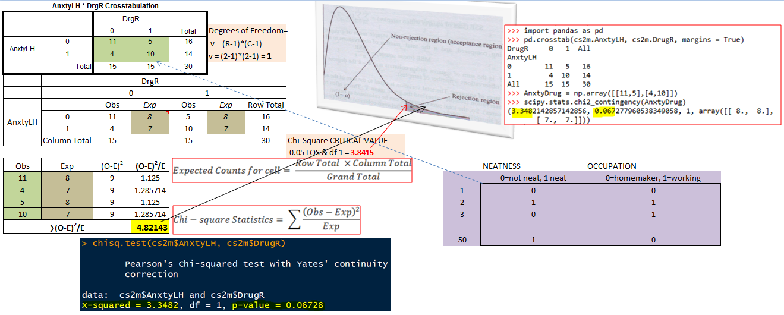
Chi Square Test Ho: There is no significant association between Anxiety and Drug Reaction

Slide 24


